Slide 1
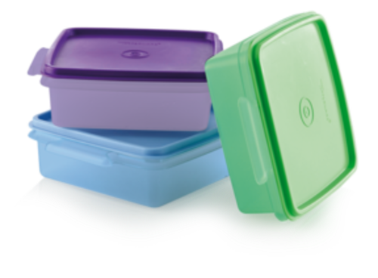
Summary Storage Virtualization

Slide 2
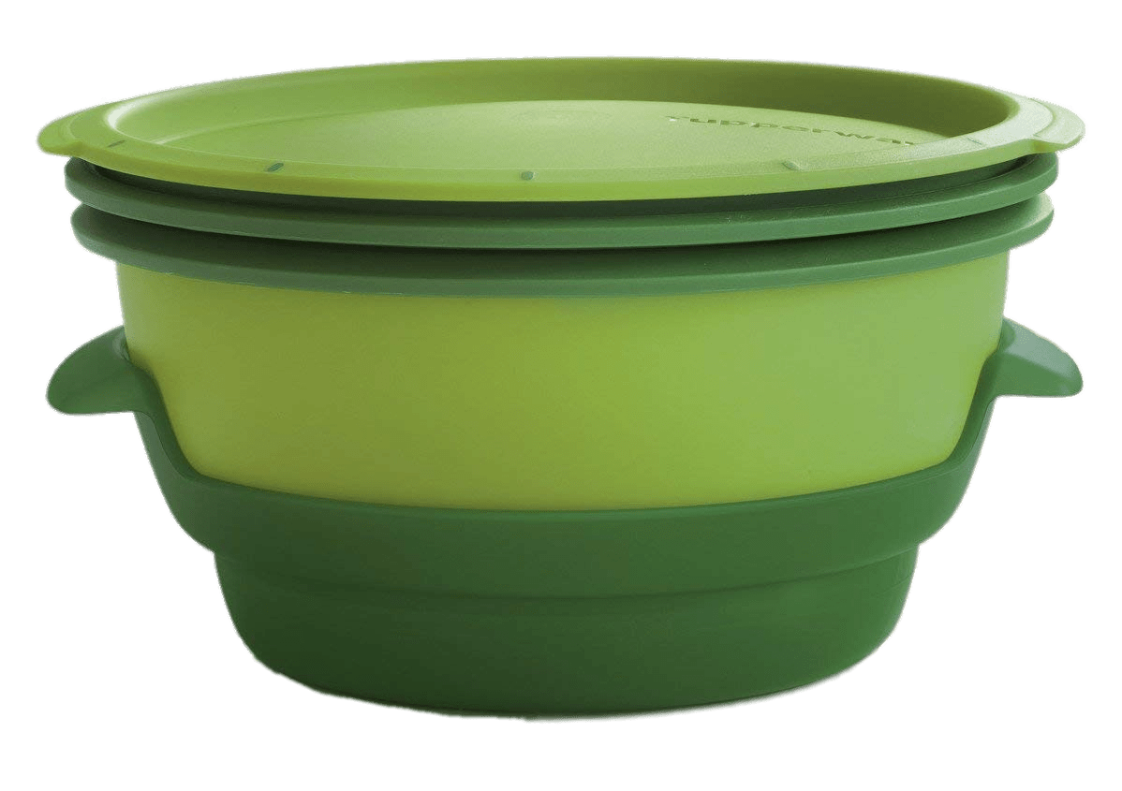
Panji Iman Baskoro
171111023
panjibaskoro.web.id

Slide 3
About Virtualization, there is a quote for it;
“… Many People talks about teenager love, but no one really understand about it… ”
- Anonymous

Slide 4
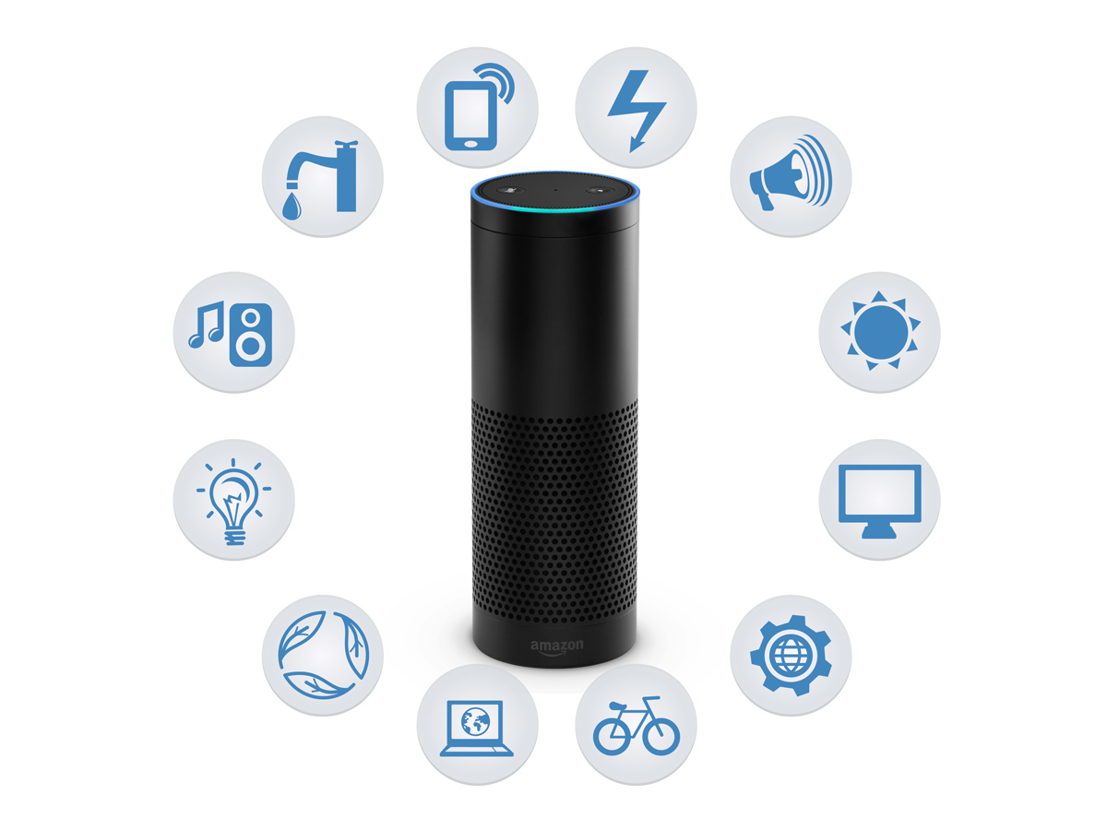
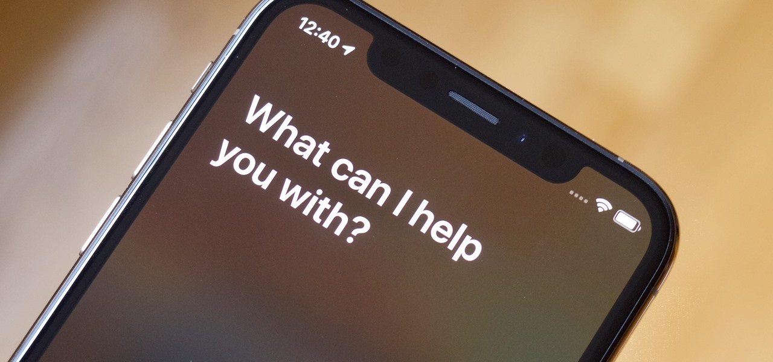

Siri virtual assistant for iphone
Alexa Smart home appliance
Q : What is the similarity of these things ?

Slide 5
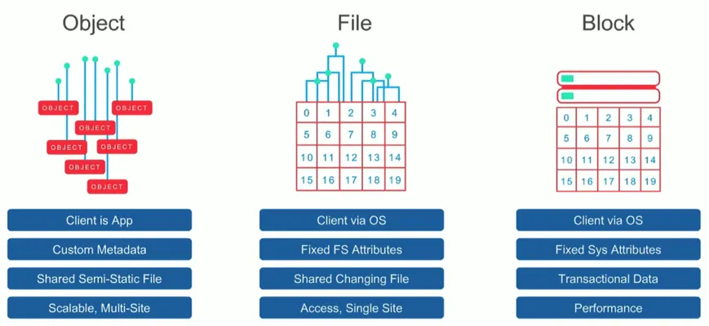
Q : What to be virtualized ?
A : it’s exactly the storage, but to be clear there is three type of storage

Slide 6
Q : What to be virtualized ?
A : Start from here we just talk about SAN (Storage Area Network) and NAS (Network Attached Storage), I think the difference is clear though.

Slide 7
Q : Where to be virtualized ?
A : Then we will do a little talk about local and cloud storage.

Slide 8
#FYITimes
You can do a storage virtualization in your local machine (PC, laptop, etc.) even in your android phone. P.S. this attempt using block storage

Slide 9
Q : Where to be virtualized ?
A : If you want to do a local storage virtualization just take a look at how virtualbox virtual storage works, it’s just a bridge to a real file storage.
Its different when you using internet for your virtual storage, at some point you can say that you using a cloud storage

Slide 10
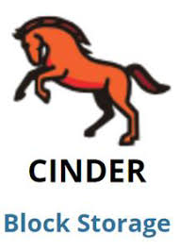

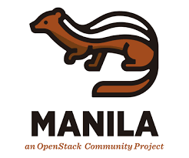
Q : Where to be virtualized ?
Object Storage
File Storage

Slide 11
Q : Where to be virtualized ?
A : If you want to do a local storage virtualization just take a look at how virtualbox virtual storage works, it’s just a bridge to a real file storage.
Its different when you using internet for your virtual storage, at some point you can say that you using a cloud storage

Slide 12
Q : How to be virtualized ?
A : You can start with using some cloud storage service like google drives or next cloud for your own private cloud storage.
Further more start learn about openstack virtual storage.

Slide 13
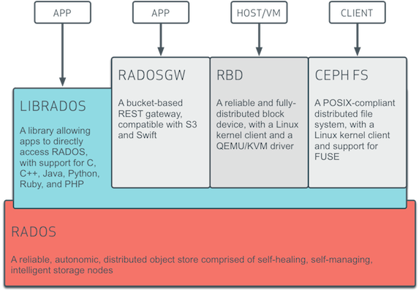
Case Study #1
In some case you can learn about RADOS its some kind of utility that ceph have to integrate object storage with block storage then it’s can be read by VM or even linux kernel.

Slide 14
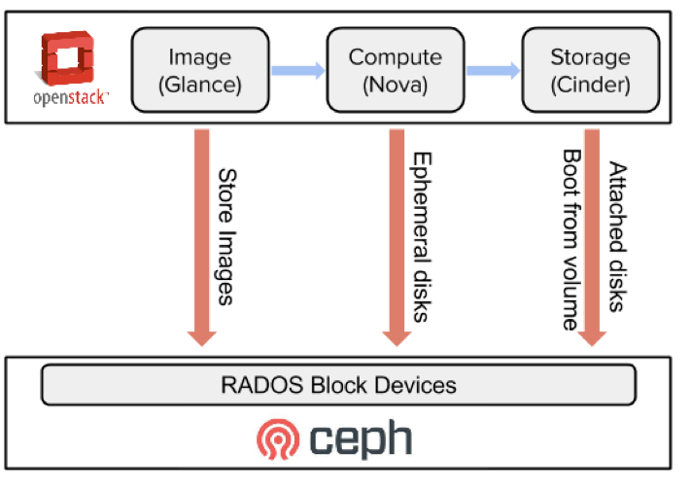
Case Study #2
Now we talk about openstack, an open source project for IaaS that widely used in world. With openstack you can choose what kind of storage that you want to use, in example I’m using object storage with ceph

